Slide 1
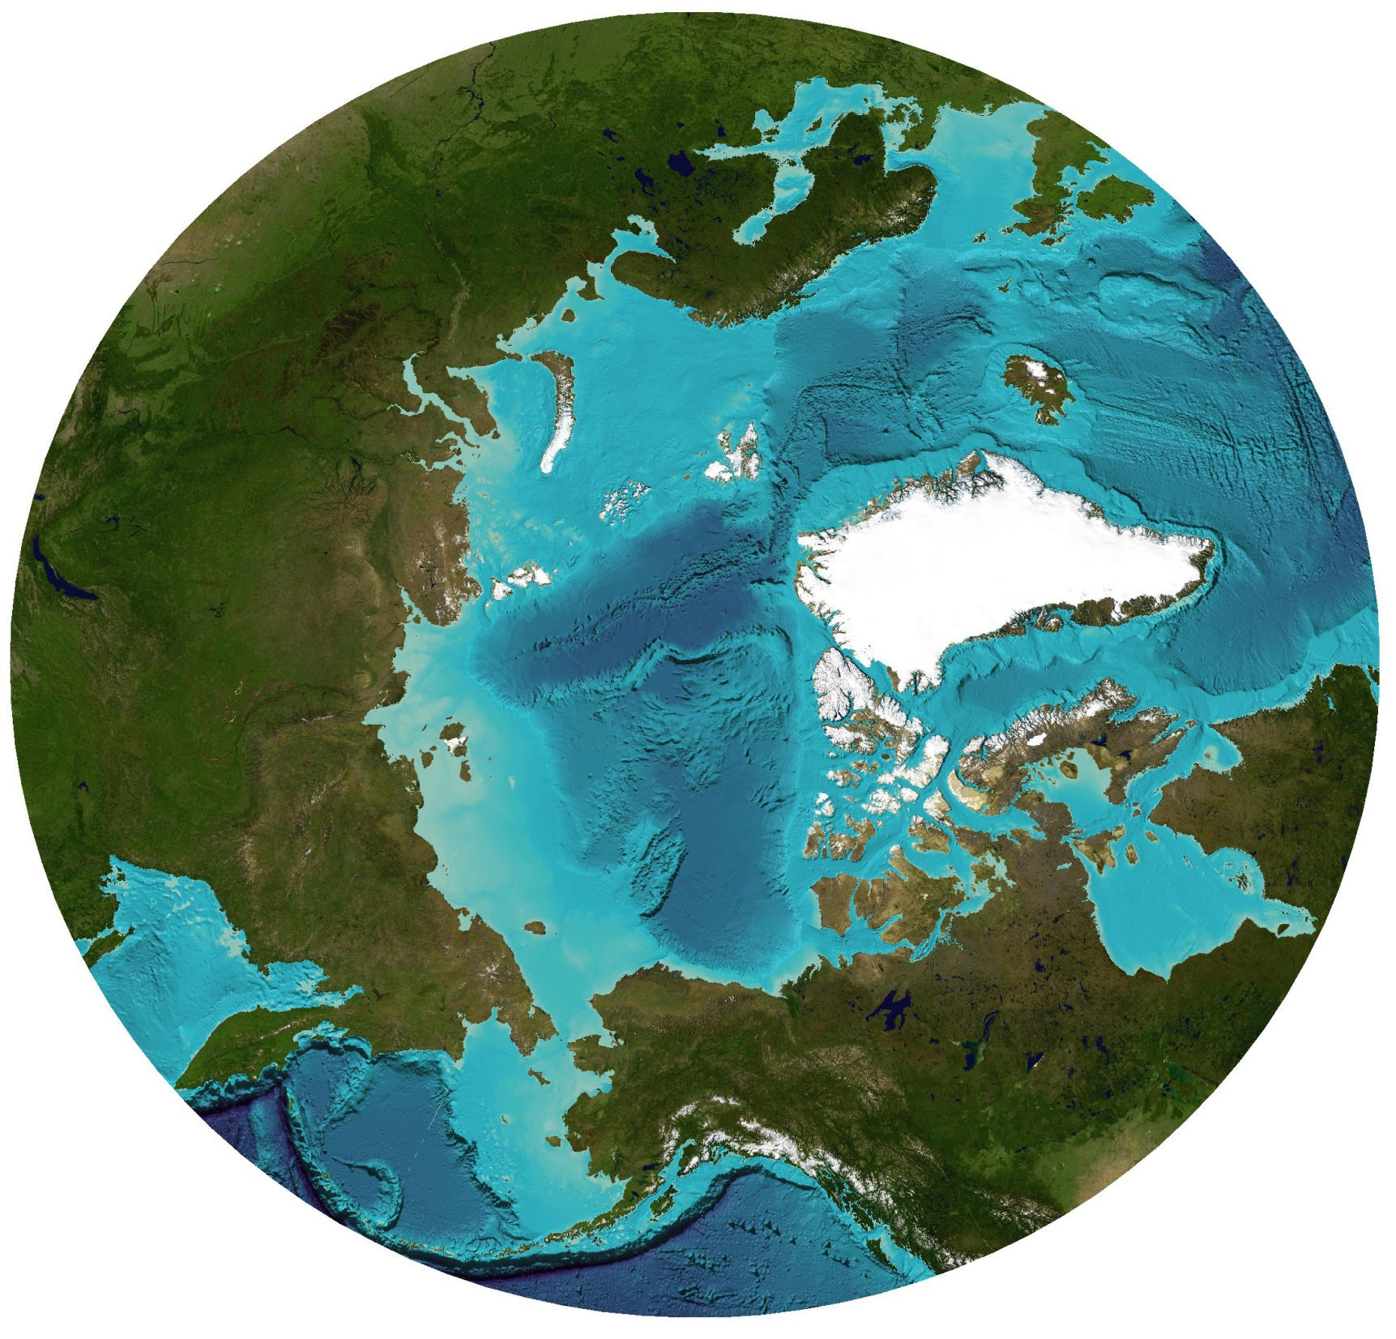
Our Neighborhood:
United States
(Alaska)
Canada
Denmark
(Greenland)
Iceland
Norway
Sweden
Finland
Russian Federation
Notes:
In addition, Alaska is geographically strategic to the nation because of our location at the top of the world, and I like to think of the Arctic from a circumpolar perspective.
Because of our location, Alaska has unique challenges and opportunities. The U.S. has to work with neighboring Arctic nations on issues of security and sovereignty, shipping, energy, fishing, and science.
The Arctic Ocean is our third great ocean border, an emerging market, and the opportunity of a lifetime.
Last May I participated in an Arctic Council meeting in Nuuk, Greenland. The meeting was attended by Sec. of State Hillary Clinton, which confirms the strategic importance of the Arctic and its waters to U.S. interests.
→ Because of Alaska’s strategic importance, I believe it is not only in Alaska’s interest, but the national interest, that our maps be updated to meet National Map Accuracy Standards.

Slide 2
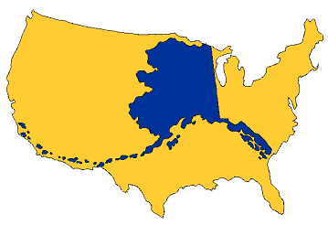
Notes:
Alaska’s geographical complexity:
With 586,412 square miles of land, is larger than all but 18 sovereign nations
Has 44,000 miles of coastline – 5x that of continental United States
Falls into five major climate zones; experiences weathers hazards ranging from tsunamis to wildfires
Has a variety of landforms, including 1,200 mile island chain, half the world’s glaciers, 17 of the 20 tallest mountains in North America
Contains a major supply of the world’s most coveted resources (oil, gas, REE’s), and the infrastructure to extract them

Slide 3
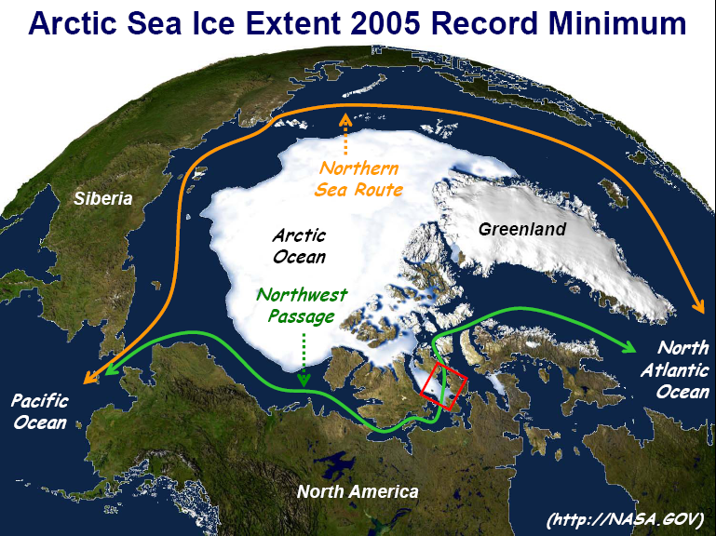
Notes:
Arctic access

Slide 4
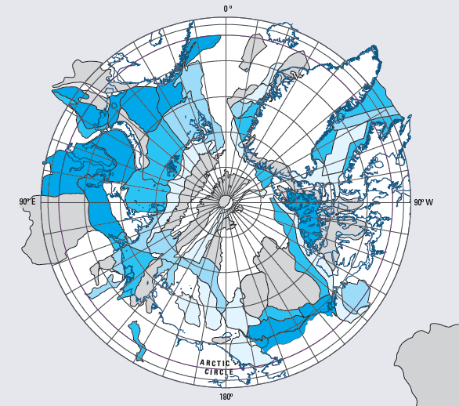
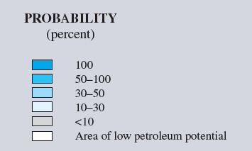
Probability of Presence of Undiscovered Oil and/or Gas Fields
USGS (2008)
Coastal Seas
Arctic Oil: 13% of world resources; gas 23%
Notes:
The U.S. Geological Survey recently reported that 13 percent of the world’s undiscovered oil and 23 percent of the world’s undiscovered gas is to be found here in the Arctic.

Slide 5
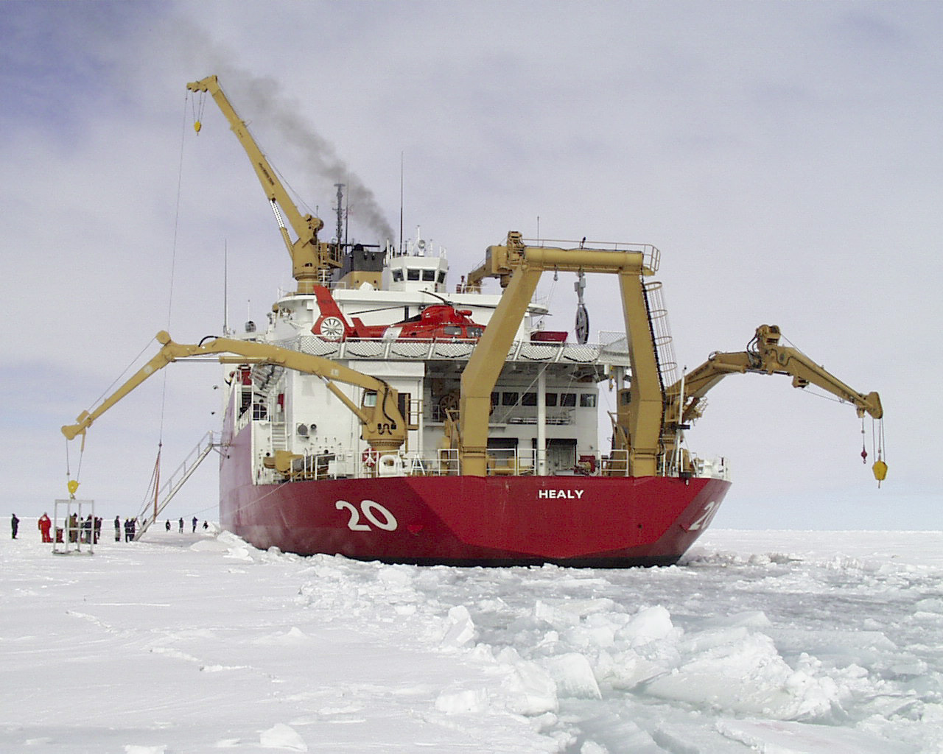
Notes:
Maps needed for planning Arctic infrastructure:
Icebreakers
Deep water ports
Vessel tracking system
Communications

